Slide 1


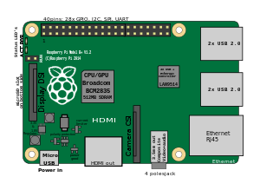


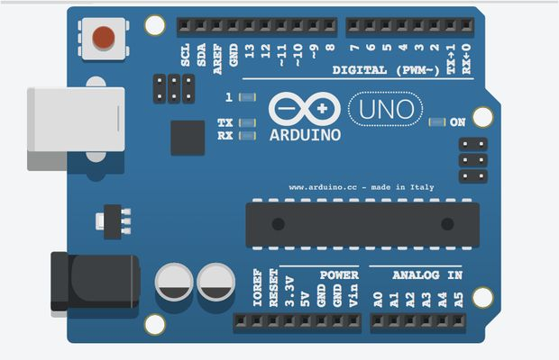

Securing

Slide 2
Intranet or Internet of Things?
Deployments involving a group of devices that communicate with each other within closed networks
“Intranets of Things”
isolated private networks that only a few entities can access
The real power of the WoT paradigm lies in opening up these silos and facilitate interconnection between devices and applications at large scale
“Internet of Things”
Why would we want this?
critical IoT system: network of industrial machines in a large factory, security system of a bank, our collection of devices at home, etc.
we don’t want these networks to be open to anyone
public data: data.gov initiatives, real-time traffic/weather/pollution conditions in a city, a group of sensors deployed in a jungle or a volcano
great to ensure that the general public anywhere could access that data
Enable anyone to create new innovative applications and possibly generate substantial economic, environmental, and social value

Slide 3
The share layer
The hotel scenario
hotel guests (and only them) should have access to devices in their room (and only there) during their stay (and only then)...
The public infrastructure is becoming not only digital but also pervasive
We need to build, deploy, scale and secure those systems in a way that various users are able to access or share some of the data or services in a safe and controlled manner
How can we ensure that
only a specific set of users can access
only a specific set of resources
at a very specific time
and in a specific manner

Slide 4
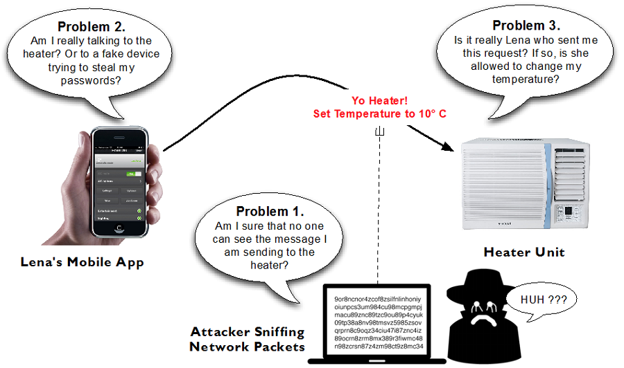
Three principal problems

Slide 5
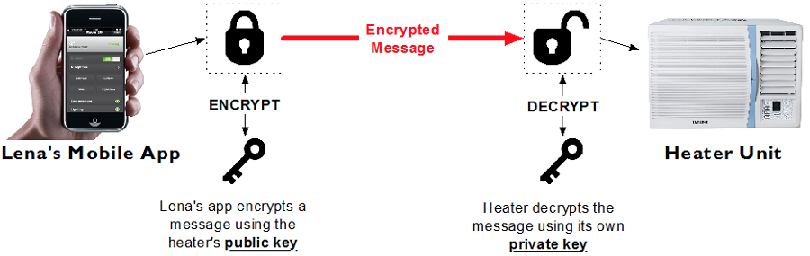
Encryption
The essential ingredient for any secure system
without encryption any attempt to secure Thing is be vain as attackers can sniff the communication and understand the security mechanisms that were put in place
Symmetric
sender and receiver share a secret key used to encode and decode a message
problem of sharing the key
Asymmetric
two related keys, one public and the other private (the secret key)
share the public key with anyone
use the public key to encode the message
once encoded, the message can be decoded only with the private key

Slide 6
TLS
Standard protocols for encrypting data on the Web
the “S” in HTTPS
SSL (Secure Socket Layer), used until 2014, then the Poodle vulnerability…
TLS (Transport Layer Security)
Two main roles
ensuring that the server is who it says it is (TLS Authentication)
guarantees that the data sent cannot be read by anyone (TLS Encryption)
Typical exchange between client and server:
client tells the server what are the protocols and encryption algorithms it supports
similar to content negotiation
server sends its certificate (the public part) to the client
clients have a list of certificates they trust
generates a key from the public certificates
used to encrypt the data going back and forth between the server and the client

Slide 7
Implementing TLS
Code: 01. Securing Web Thing
Install OpenSSL library and generate a certificate
openssl req -x509 -newkey rsa:2048 -keyout privateKey.pem -out caCert.pem -days 1095 -sha256
it generate a private key: “-newkey rsa:2048 -keyout privateKey.pem”
that key is used to sign the certificate using SHA256 algo: “-sha256”
the procedure ask for a password (to protect the private key) and some info
generate a new certificate “-out caCert.pem”
it will last for 1095 days using the x509 data format “-x509 -days 1095”
see folder resources/
Two new files will be generated
privateKey.pem, which is the private key of your server (should be kept private)
caCert.pem is the public part that will be sent to clients when connecting via TLS
Turn HTTP and WS APIs into secure HTTPS and WSS APIs
see servers/http.js
Run the server and try to connect (remember https!)
you should get a warning saying that the connection is not private
this means that the certificate was generated by you (ERR_CERT_AUTHORITY_INVALID)
a Certificate Authority (CA) not trusted by your browser

Slide 8
Certificate Authority
While the encryption of messages works with self-signed certificates, the authenticity of the server cannot be guaranteed
the chain of trust is broken
attackers could pretend to be the Thing you think you are talking to
Not a big deal when your Things are on the local network, but critical on the public Internet
Get certificates from well-known and trusted Certificate Authority (CA)
e.g. Thawte, Symantec or GeoTrust
they verify who created the certificates (various degrees of rigor…)
not for free
Business of selling Web security!
unfortunate consequence: a number of sites use cheaper CAs that do a less good job at checking to whom they deliver certificates….
Let’s Encrypt (https://letsencrypt.org/)
provides free and secure certificates for the public’s benefit
a number of major actors of the Web

Slide 9
Authentication and Access Control
We want to enable only some applications to access API
the hotel control center needs to have full access to all devices and the ability to configure and administer them
however, guest in room 212 only needs to access the devices and services in that room, she should not be able to configure them, but only send a limited set of commands
Need to be able to know the sender of each request
Identification
Devices need to trust that the sender really is who she claims to be
Authentication
Devices also need to know if they should accept or reject each request depending on the identity of the sender
Authorization
Encryption is like sending a postcard in an envelope, authentication is like sending that envelope via registered mail
the postman will only deliver the letter to the correct recipient
Token-based authentication
a secret token can be used to authenticate each request sent by that client

Slide 10
Token-based authentication
The API token should be generated using cryptographically strong pseudorandom generator
see resources/auth.json
Modify the server so that for each request that comes in, we check if the request is signed using a valid API Key
use the middleware pattern
see middleware/auth.js
see servers/http.js
This is minimal implementation
we manually check each request against a hard-coded API key
far from a scalable and reliable solution ready for production
The actual solution will depend on the actual use case of your device and applications
different users that all need to have their own token, or it is fine to have only a single token?
how granular access control do you need?
how often will you need to add/remove permissions?

Slide 11
oAuth: web authorization framework
API tokens with encryption (TLS) is the bare minimum, challenges
we need a process to generate and retrieve tokens dynamically
creating the mechanism to get tokens would not foster interoperability (make the process complicated)
token should not be valid forever (just like passwords, should change on a regular basis)
Possible solution:
JSON Web Token (JWT) open standard (RFC 7519, https://tools.ietf.org/html/rfc7519)
There is a Web standard coming to our rescue: OAuth
open standard to delegate the authentication of a user to a third-party trusted service
e.g., Facebook, LinkedIn or Google
allows sharing resources between applications
for instance, you can allow some of your Facebook friends to access securely some of your documents on Google
OAuth standardizes
how to authenticate users
generate tokens with an expiration date
re-generate tokens
provide access to resources in a secure and standard manner over the Web

Slide 12
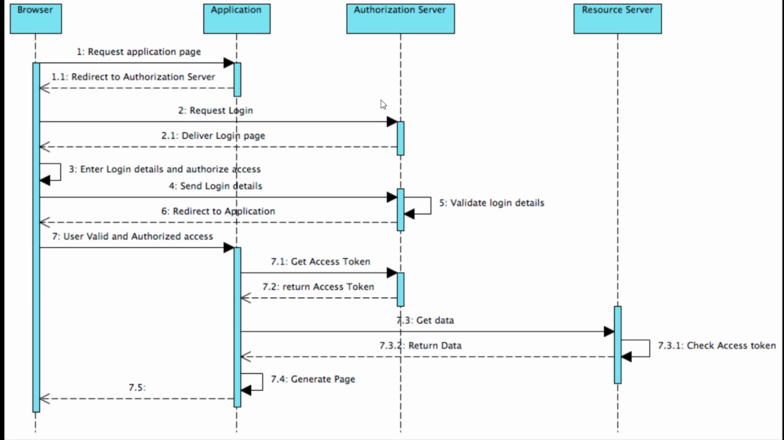
oAuth roles and process

Slide 13
oAuth server
Implementing OAuth server on a Linux based embedded device is not hard
the protocol isn’t really heavy
But maintaining the list of all applications, users and their access scope on each Thing is clearly not going to work and scale for the IoT
e.g. in the hotel, the heater (and all other devices) would need to know about all the clients
Example of servers:
Social Networks (Facebook, Google, LinkedIn, Twitter,etc.)
Developer services (e.g., GitHub, BitBucket, etc.)
many others Web sites (e.g., TripAdvisor, Meetup, etc.)
The Social Web of Thing!
create an authentication proxy that controls access to all Things it proxies and also does so by identifying users of client applications using trusted third-party services
Node Passport Module
http://www.passportjs.org/

Slide 14
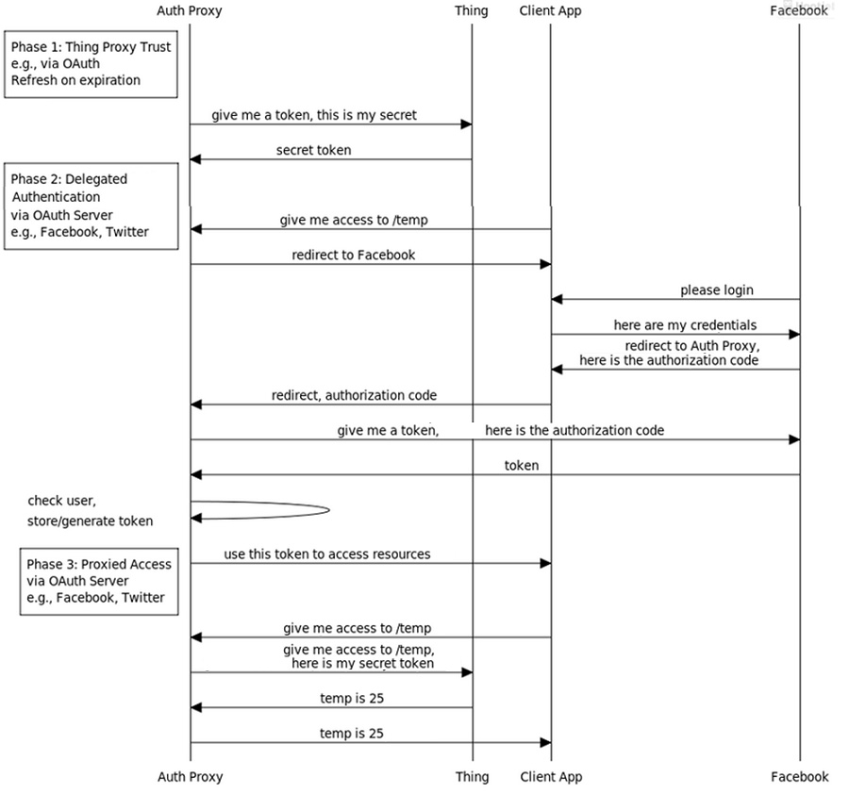
Social Web of Things

Slide 15
Social Web of Things
Thing Proxy Trust
ensure that the proxy can access resources on the Thing securely
if the Thing is protected by an API Token (Device Token), it could be as simple as storing this token
if the Thing is also an OAuth server then this step follows an OAuth authentication flow
after this phase the proxy has a secret that lets it access the resources of the Thing
Delegated Authentication
a Client App authenticates via an OAuth Authorization Server
the Authentication Proxy uses the Access Token returned by the authorization server to identify the user of the client app and checks if the user is authorized to access the Thing
if he is, the proxy returns the Access Token to the Client App
Proxied Access
once the Client App has a token, it can use it to access the resources of the Thing through the Authentication Proxy
if the token is valid, the Authentication Proxy will forward the request to the Thing using the secret (Device Token) it got in first phase and send the response back to the Client App

